Slide 1


IT Data Security Lecture Series
V Semester CSF
Dr. Narendra Kumar Dewangan
Assistant Professor, Senior Scale
Systems, School of Computer Sciences
UPES Dehradun
Countermeasures

Slide 2

Contents
Introduction,
The Importance of Data Protection,
Evolution of Mitigation Technique,
Countermeasures,
Database Security Countermeasures.

Slide 3
Countermeasures Defined
Countermeasures in computer security refer to methods to protect computer systems and networks from cyber threats.
Employing countermeasures in computer security often safeguards valuable digital assets and sensitive information from a variety of threats.
Countermeasures can be used to detect, prevent or mitigate the impact of an attack on an organization's computer system, network or device.
As cyber threats grow, the need for effective countermeasures becomes more vital than ever.
This prompts organizations and individuals alike to take proactive steps to defend their digital environments effectively.

Slide 4
Types of Countermeasures
Physical Security Countermeasures
Financial Countermeasures
Operational Security Countermeasures
Legal Countermeasures

Slide 5
Common Countermeasures Used in Computer Security
As cyberattacks have grown in complexity and frequency, it has become increasingly imperative for organizations to stay informed and vigilant about the various computer security countermeasures that can be taken. Protecting information and systems from unauthorized access, use, tampering or destruction is essential to maintaining the integrity and confidentiality of sensitive information for companies.
These methods are commonly used to fortify computer systems against malicious actors. These countermeasures highlight the significant role they play in effectively safeguarding company digital assets. The following are some of the common types of countermeasures used in computer security countermeasures.

Slide 6
Common Countermeasures Used in Computer Security
Identity and Access Management (IAM)
Network Security Controls
Intrusion Detection and Prevention Systems
Data Loss Prevention and Recovery

Slide 7
The Importance of Data Protection
Data breaches can lead to severe financial, reputational, and legal consequences for organizations
Regulations such as GDPR (General Data Protection Regulation) in Europe and CCPA (California Consumer Privacy Act) in the U.S. impose strict data privacy requirements, highlighting the need for robust data protection measures
Effective data protection fosters customer trust, reduces the risk of financial penalties, and ensures business continuity
It safeguards both individuals' privacy rights and sensitive business information from cyber threats.

Slide 8
Data breaches can lead to severe financial, reputational, and legal consequences for organizations
Financial Consequences
Direct Costs
Indirect Costs
Example 1: Equifax (2017)
In 2017, Equifax, one of the largest credit reporting agencies, suffered a data breach that exposed the personal information (including Social Security numbers and credit card details) of approximately 147 million individuals.
Financial Consequences: Equifax incurred over $1.4 billion in fines and settlements and spent hundreds of millions in upgrading its cybersecurity infrastructure. The company also had to pay $700 million as part of a settlement with the Federal Trade Commission (FTC).

Slide 9
Data breaches can lead to severe financial, reputational, and legal consequences for organizations
Reputational Damage
The damage to an organization's reputation after a data breach can be long-lasting. Trust is a critical asset for any business, especially those handling sensitive personal information, such as financial institutions, healthcare providers, or e-commerce companies. When this trust is compromised, the consequences include:
Customer Trust Loss: Once customers believe that their personal data is not safe, they may switch to competitors.
Brand Image Erosion: Negative media coverage and public perception damage can take years to recover from, and the organization's brand may never fully regain its previous standing.
Investor Confidence Decline: Shareholders and investors may lose confidence in the company's leadership and cybersecurity posture, which can affect stock prices and long-term business stability.

Slide 10
Data breaches can lead to severe financial, reputational, and legal consequences for organizations
Example : Marriott International (2018)
In 2018, Marriott disclosed that hackers had stolen data from its Starwood guest reservation system, affecting approximately 500 million customers.
Reputational Consequences: Marriott faced negative press coverage and customer backlash. It spent years trying to rebuild customer confidence. Though the company attempted to mitigate the breach's impact, the incident harmed its reputation as a trusted global hospitality brand.

Slide 11
Data breaches can lead to severe financial, reputational, and legal consequences for organizations
Legal Consequences
Regulatory Fines: Agencies such as the EU’s General Data Protection Regulation (GDPR) and the California Consumer Privacy Act (CCPA) impose significant fines on companies that fail to protect user data or disclose breaches in a timely manner.
Class Action Lawsuits: Affected customers may file lawsuits seeking compensation for the damages they suffered from the breach. This can result in large settlements.
Government Investigations: Regulatory bodies may launch investigations into how the breach occurred and how well the company’s security policies align with legal requirements.

Slide 12
Data breaches can lead to severe financial, reputational, and legal consequences for organizations
Legal Consequences
Example: Capital One (2019)
In 2019, Capital One was the victim of a breach in which the personal information of over 100 million credit card applicants was compromised.
Legal Consequences: The company faced a $80 million fine by the U.S. Office of the Comptroller of the Currency (OCC) for failing to establish effective risk management practices before migrating to the cloud.

Slide 13
Regulations such as GDPR Privacy
Both GDPR (General Data Protection Regulation) and CCPA (California Consumer Privacy Act) are landmark data privacy regulations enacted to protect individuals' personal data and impose strict obligations on organizations that collect, store, and process this data. While GDPR applies to the European Union (EU), CCPA focuses on California residents. Below is a detailed overview of these regulations and examples demonstrating how they impact businesses.

Slide 14
GDPR (General Data Protection Regulation)
Enacted in May 2018, the GDPR is a regulation by the European Union (EU) that governs the collection, storage, and processing of personal data of individuals within the EU.GDPR applies not only to organizations based in the EU but also to any company worldwide that processes the data of EU citizens.
It provides strict rules about data transparency, user consent, the right to access and delete data, and mandates clear reporting of data breaches.

Slide 15
GDPR (General Data Protection Regulation)
Key Requirements:
Lawful Basis for Processing: Organizations must have a lawful basis to process personal data, such as consent, contract fulfillment, or compliance with legal obligations.
Consent: Companies must obtain clear, informed, and freely given consent from individuals before collecting their personal data.
Data Subject Rights: Individuals have the right to access their personal data, request corrections, and demand data deletion ("right to be forgotten").
Data Breach Notification: Organizations must report data breaches to relevant authorities within 72 hours of discovery and notify affected individuals if there’s a high risk to their privacy.
Data Minimization: Organizations must only collect the data they need for the specific purpose they have identified.
Penalties: Non-compliance can result in fines of up to €20 million or 4% of the organization’s global annual revenue, whichever is higher.

Slide 16
Example : Google GDPR Fine (2019)
In 2019, the French data protection authority CNIL fined Google €50 million for GDPR violations.
Google failed to properly inform users about how their data was being used for personalized advertising and did not obtain explicit user consent.
This case highlighted the GDPR’s strict requirements for transparency and how companies must provide clear and accessible information about data usage.

Slide 17
CCPA (California Consumer Privacy Act)
Effective January 2020, the CCPA is the first comprehensive data privacy law in the United States and applies to businesses that collect personal data from California residents.
The CCPA aims to enhance privacy rights for California consumers and give them more control over their personal information.
It imposes specific obligations on companies, including data disclosure, the right to opt out of data sales, and the right to delete personal data.

Slide 18
Key Requirements:
Consumer Rights: California residents have the right to know what personal data is being collected, the purpose for which it is collected, and who it is shared with. They can request access to or deletion of their data.
Opt-Out of Data Sale: Consumers have the right to opt out of the sale of their personal data to third parties, and companies must provide a "Do Not Sell My Personal Information" link on their websites.
Disclosure and Transparency: Businesses must disclose their data collection practices, including the types of data collected and the purposes for which they are used, both in privacy policies and upon consumer requests.

Slide 19
Key Requirements:
Data Breach Penalties: CCPA grants consumers the right to sue companies for data breaches that result from negligence, with potential statutory damages ranging from $100 to $750 per incident, or more for actual damages.
Penalties for Non-Compliance: The California Attorney General can levy fines of up to $7,500 per intentional violation or $2,500 for unintentional violations.

Slide 20
Example: Salesforce and Oracle Lawsuit (2020)
In 2020, Salesforce and Oracle faced a class-action lawsuit for allegedly violating the CCPA by collecting and selling personal data without user consent.
The companies were accused of using third-party cookies to track user behavior and sell that information for targeted advertising purposes without properly informing consumers or obtaining their consent.
This case emphasizes the CCPA's focus on user consent and disclosure, especially in the context of online tracking and behavioral advertising.

Slide 21
Evolution of Mitigation Techniques
Over the years, cybersecurity has evolved from basic password protection to advanced encryption and biometric systems.
Initially, mitigation techniques focused on perimeter defense (firewalls, anti-virus software) but have since expanded to include holistic, multi-layered approaches.
Technologies such as encryption, tokenization, multi-factor authentication, and zero-trust models are now commonly used to protect sensitive data.
Emerging trends like AI and machine learning are playing an increasing role in proactive threat detection and response, helping to mitigate risks before breaches occur.

Slide 22
Early Data Security Techniques (1960s–1980s)
During the early days of computing, security measures were rudimentary, mainly because the concept of cyber threats was not as well developed. The primary focus was on physical security and ensuring that only authorized individuals could access systems. As computers evolved, so did the need for more advanced techniques.
Key Techniques:
Password Authentication: One of the earliest methods for protecting systems, requiring users to provide a password to access the system.
Basic Access Control Lists (ACLs): Early operating systems included ACLs to define which users or system processes were granted access to objects like files or directories.
File System Permissions: Users could set permissions (read, write, execute) on individual files and folders to prevent unauthorized access.
Challenges:
Simple passwords were easy to guess or compromise.
Physical access controls were insufficient for the rising complexity and connectivity of systems.

Slide 23
The Rise of Network Security (1980s–1990s)
As networks began connecting computers, new vulnerabilities emerged, particularly with the rise of the internet. Network-based attacks such as eavesdropping, man-in-the-middle attacks, and brute-force password attacks became prevalent, necessitating a shift in focus toward securing data in transit and within networks.
Key Techniques:
Firewalls: Introduced in the late 1980s, firewalls were designed to filter incoming and outgoing network traffic based on security rules, creating a barrier between trusted internal networks and untrusted external networks.
Data Encryption (DES, RSA): Early forms of encryption, such as the Data Encryption Standard (DES) and RSA public-key cryptography, became essential for protecting sensitive data during transmission.
DES (developed in the 1970s) was widely adopted for encrypting data, but as computing power increased, it became vulnerable to brute-force attacks.
RSA public-key cryptography introduced secure methods for exchanging encryption keys and securely transmitting data.
Antivirus Software: Early antivirus programs were developed to detect and remove malicious software like viruses and worms.
Access Control Models: More sophisticated models, such as Discretionary Access Control (DAC) and Mandatory Access Control (MAC), were introduced to regulate user access based on roles and security clearance levels.
Challenges:
Firewalls were limited in scope and unable to handle more complex attacks like application-layer intrusions.
DES was eventually broken due to its relatively short key length, leading to the need for stronger encryption standards.

Slide 24
Modern Data Security (2000s–2010s)
The rapid growth of the internet, e-commerce, cloud computing, and mobile devices introduced a wide range of vulnerabilities. Attack vectors expanded beyond traditional viruses to include phishing, ransomware, advanced persistent threats (APTs), and SQL injection attacks. As a result, organizations required more robust and multi-layered defense strategies.
Key Techniques:
Advanced Encryption Standards (AES): Replacing DES, the AES algorithm (established in 2001) became the new encryption standard for securing data due to its stronger encryption keys and resilience against brute-force attacks.
Intrusion Detection Systems (IDS) and Intrusion Prevention Systems (IPS): These systems were developed to detect and prevent unauthorized access to networks. IDS monitors traffic for suspicious activity, while IPS blocks malicious traffic in real time.
Multi-Factor Authentication (MFA): MFA adds an additional layer of security by requiring multiple forms of verification (such as a password and a biometric scan) before allowing access to a system or data.

Slide 25
Modern Data Security (2000s–2010s)
Transport Layer Security (TLS): TLS is the successor to SSL (Secure Sockets Layer) and provides encrypted communication between web servers and clients. It ensures data integrity and confidentiality in internet communications.
Public Key Infrastructure (PKI): PKI involves the use of certificates and public-private key pairs to establish a secure framework for exchanging sensitive data over the internet. It supports digital signatures and secure email exchanges.
Virtual Private Networks (VPNs): VPNs create secure tunnels for data transmission over untrusted networks (such as the internet), ensuring the confidentiality and integrity of data between remote users and private networks.
Data Loss Prevention (DLP): DLP solutions monitor and control the movement of sensitive data to prevent unauthorized transfers or leaks, whether intentional or accidental.
Challenges:
With the increasing use of web applications, vulnerabilities like cross-site scripting (XSS) and SQL injections became common attack vectors.
Sophisticated phishing attacks and insider threats made it difficult for traditional security measures to fully protect organizations.

Slide 26
Emerging and Current Data Security Techniques (2010s–Present)
The explosion of cloud computing, Internet of Things (IoT) devices, artificial intelligence (AI), and the rise of big data have further expanded the attack surface for cybercriminals. This era has seen the adoption of more proactive and intelligent security mechanisms.
Key Techniques:
Zero Trust Architecture (ZTA): A model that assumes no user or system is inherently trusted, whether inside or outside the network. All users must authenticate and be authorized for every access request, minimizing the risk of insider threats and lateral movement within a compromised network.
Artificial Intelligence (AI) and Machine Learning (ML) in Cybersecurity: AI and ML models are increasingly being used to detect patterns, predict potential breaches, and respond automatically to cyber threats. These models can identify anomalous behavior in real-time and adapt to evolving attack tactics.
Behavioral Analytics: This technique monitors user behavior (such as login patterns or transaction habits) to detect deviations from normal patterns that might indicate a breach or compromised account.
Cloud Security: Cloud service providers have developed a range of security measures, such as cloud encryption, identity and access management (IAM), and cloud-based firewalls, to secure data stored and processed in the cloud.
Homomorphic Encryption: A method that allows data to be processed without decrypting it, providing security for sensitive data even during computation. This is particularly useful in multi-party computations or when using cloud services for processing encrypted data.

Slide 27
Emerging and Current Data Security Techniques (2010s–Present)
Blockchain for Data Security: Blockchain technology’s decentralized and tamper-proof nature is being explored as a method to secure data, manage identity, and ensure the integrity of transactions, particularly in financial services and supply chains.
Endpoint Detection and Response (EDR): EDR systems monitor end-user devices (laptops, smartphones, IoT devices) for signs of malware or unusual activity. These systems provide continuous monitoring and automated responses to isolate and mitigate threats.
Encryption at Rest, In Transit, and In Use: Organizations now employ encryption for data stored (at rest), in transit (between systems), and even during processing (in use), ensuring that sensitive data remains secure throughout its lifecycle.
Challenges:
Despite advances in AI and automation, cybercriminals also use AI-driven attacks, making it a cat-and-mouse game between defenders and attackers.
Cloud misconfigurations and lack of visibility into third-party service providers continue to pose significant risks for organizations.

Slide 28
Future Trends in Data Security
Quantum-Safe Cryptography: With the advent of quantum computing, existing cryptographic methods (like RSA and ECC) may become obsolete. Research is ongoing into quantum-safe encryption algorithms that can withstand the computational power of quantum computers.
AI-Driven Autonomous Security Systems: AI-powered security systems that can autonomously detect and mitigate threats will become more prevalent. These systems will rely on vast amounts of data and real-time analytics to respond to breaches faster than human capabilities.
Decentralized Identity Systems: Blockchain and distributed ledger technology (DLT) will likely play a key role in developing decentralized identity systems, reducing the reliance on centralized databases for identity management and thereby reducing the risk of breaches.

Slide 29
Countermeasures
Encryption: Transforming data into an unreadable format without a decryption key, preventing unauthorized access.
Access Control: Implementing role-based access to ensure only authorized individuals can interact with specific data.
Multi-Factor Authentication (MFA): Adding layers of security by requiring users to verify their identity through multiple methods.
Intrusion Detection and Prevention Systems (IDPS): These systems monitor network or system activities for malicious actions or policy violations.
Data Masking: Protecting sensitive data by replacing it with fictitious information in environments where real data is not necessary.

Slide 30
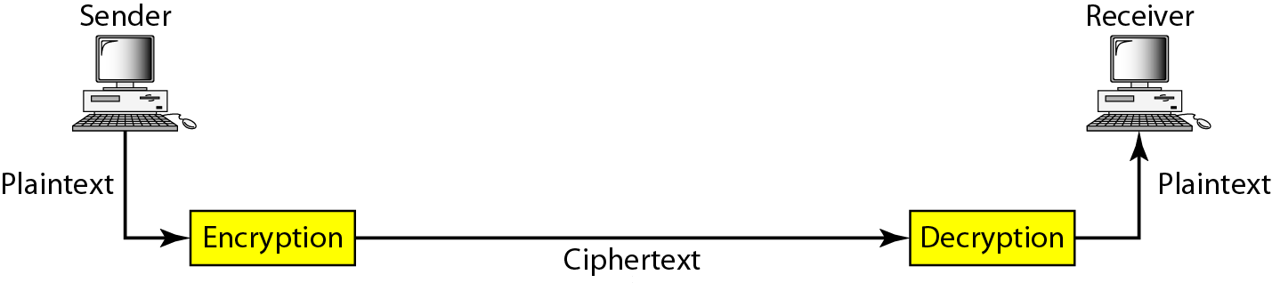
Figure 30.1 Cryptography components

Slide 31
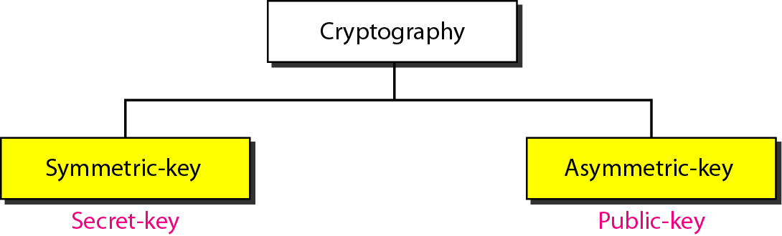
Figure 30.2 Categories of cryptography

Slide 32
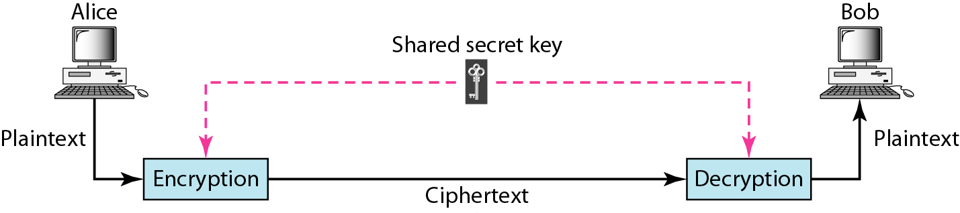
Figure 30.3 Symmetric-key cryptography

Slide 33

Note
In symmetric-key cryptography, the same key is used by the sender
(for encryption) and the receiver (for decryption).
The key is shared.

Slide 34
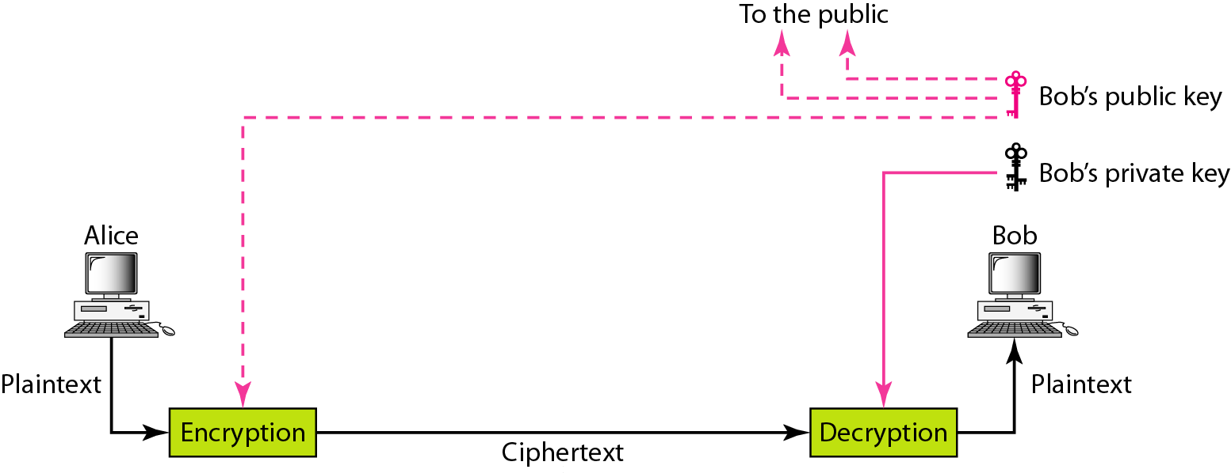
Figure 30.4 Asymmetric-key cryptography

Slide 35
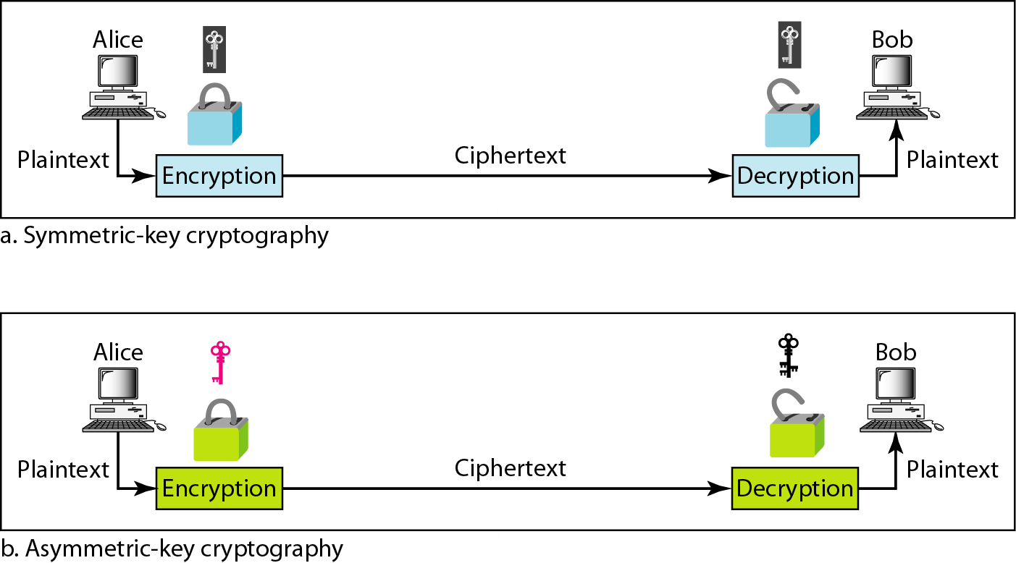
Figure 30.6 Comparison between two categories of cryptography

Slide 36
30-2 SYMMETRIC-KEY CRYPTOGRAPHY
Symmetric-key cryptography started thousands of years ago when people needed to exchange secrets (for example, in a war). We still mainly use symmetric-key cryptography in our network security.
Topics discussed in this section:
Traditional Ciphers Simple Modern Ciphers Modern Round Ciphers Mode of Operation

Slide 37
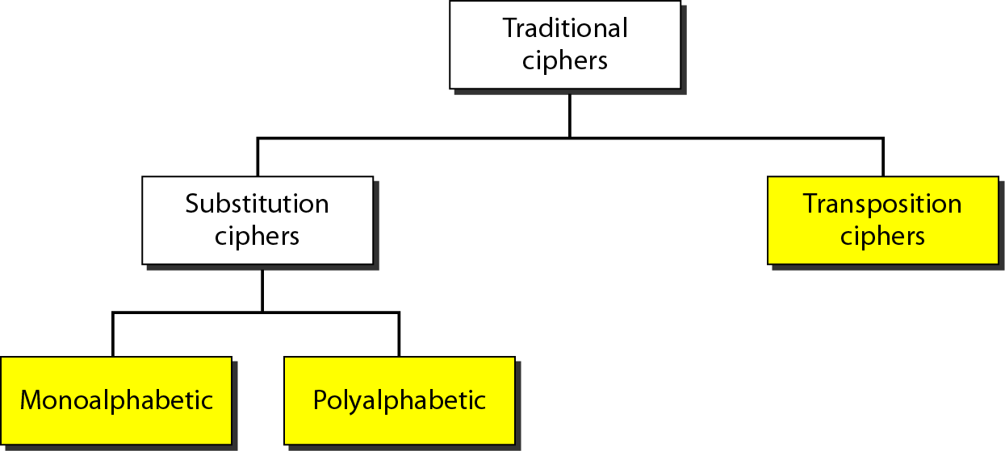
Figure 30.7 Traditional ciphers

Slide 38
Note
A substitution cipher replaces one symbol with another.
Monoalphabetic replaces the same symbol with the same another symbol.
Polyalphabetic replaces the same symbol with different symbols at each occurrence.

Slide 39
Note
The shift cipher is sometimes referred to as the Caesar cipher. (monoalphabetic)

Slide 40
Example 30.3
Use the shift cipher with key = 15 to encrypt the message “HELLO.”
Solution
We encrypt one character at a time. Each character is shifted 15 characters “down”. Letter H is encrypted to W. Letter E is encrypted to T. The first L is encrypted to A. The second L is also encrypted to A. And O is encrypted to D. The cipher text is WTAAD.

Slide 41
Example 30.4
Use the shift cipher with key = 15 to decrypt the message “WTAAD.”
Solution
We decrypt one character at a time. Each character is shifted 15 characters “up”. Letter W is decrypted to H. Letter T is decrypted to E. The first A is decrypted to L. The second A is decrypted to L. And, finally, D is decrypted to O. The plaintext is HELLO.

Slide 42
Note
A transposition cipher reorders (permutes) symbols in a block of symbols (shuffle poker cards)

Slide 43
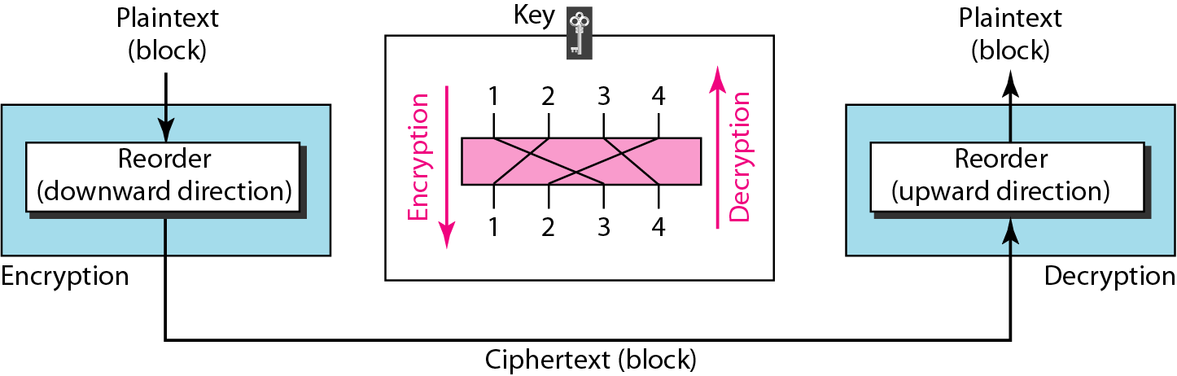
Figure 30.8 Transposition cipher

Slide 44
Example 30.5
Encrypt the message “HELLO MY DEAR,” using the key shown in Figure 30.8.
Solution
We first remove the spaces in the message. We then divide the text into blocks of four characters. We add a bogus character Z at the end of the third block. The result is HELL OMYD EARZ. We create a three-block ciphertext ELHLMDOYAZER.

Slide 45
Example 30.6
Using Example 30.5, decrypt the message “ELHLMDOYAZER”.
Solution
The result is HELL OMYD EARZ. After removing the bogus character and combining the characters, we get the original message “HELLO MY DEAR.”

Slide 46
Modern Cryptography

Slide 47
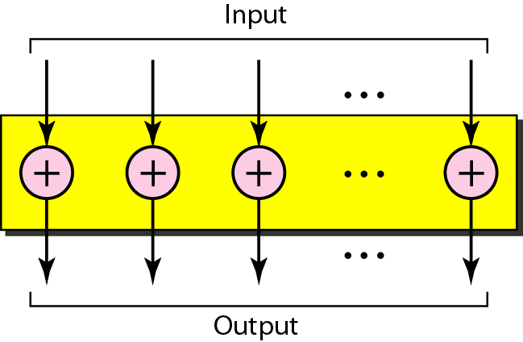
Figure 30.9 XOR cipher

Slide 48
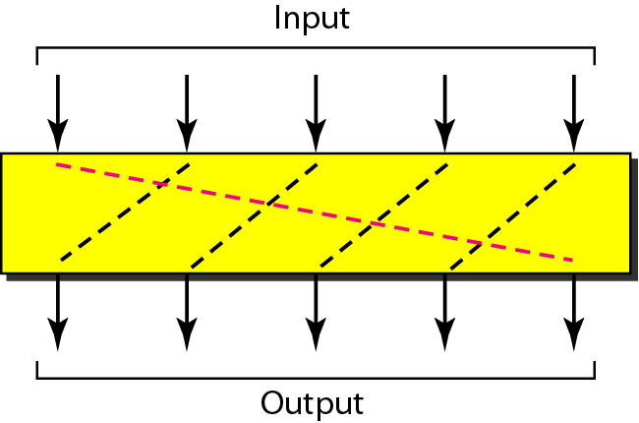
Figure 30.10 Rotation cipher

Slide 49
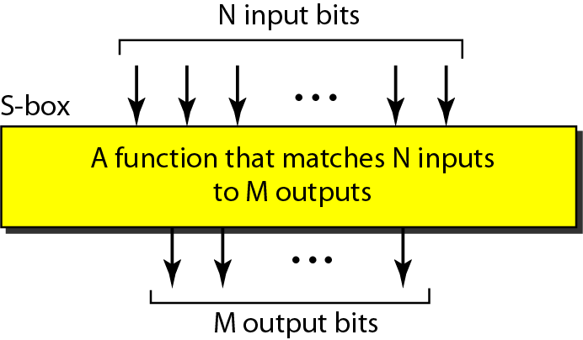
Figure 30.11 S-box (substitution box)

Slide 50
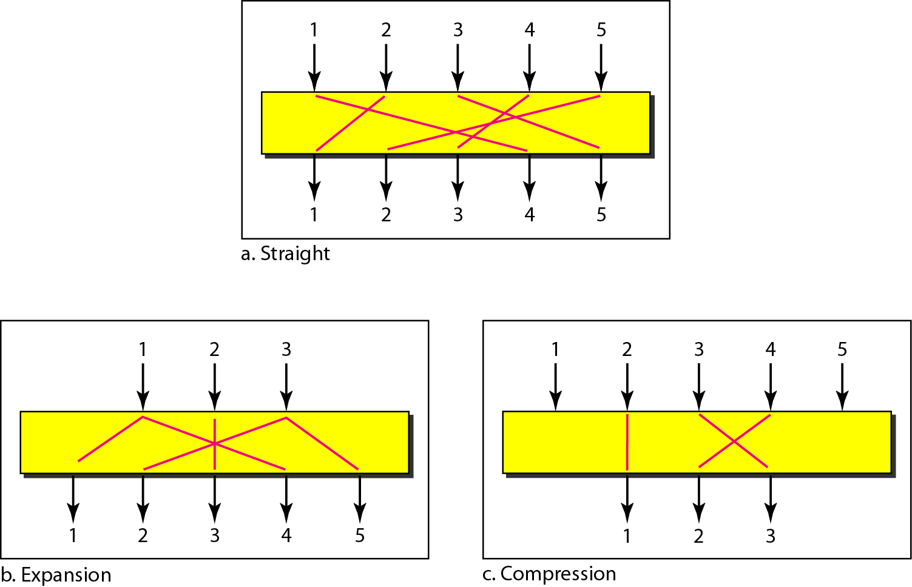
Figure 30.12 P-boxes (permutation box): straight, expansion, and compression

Slide 51
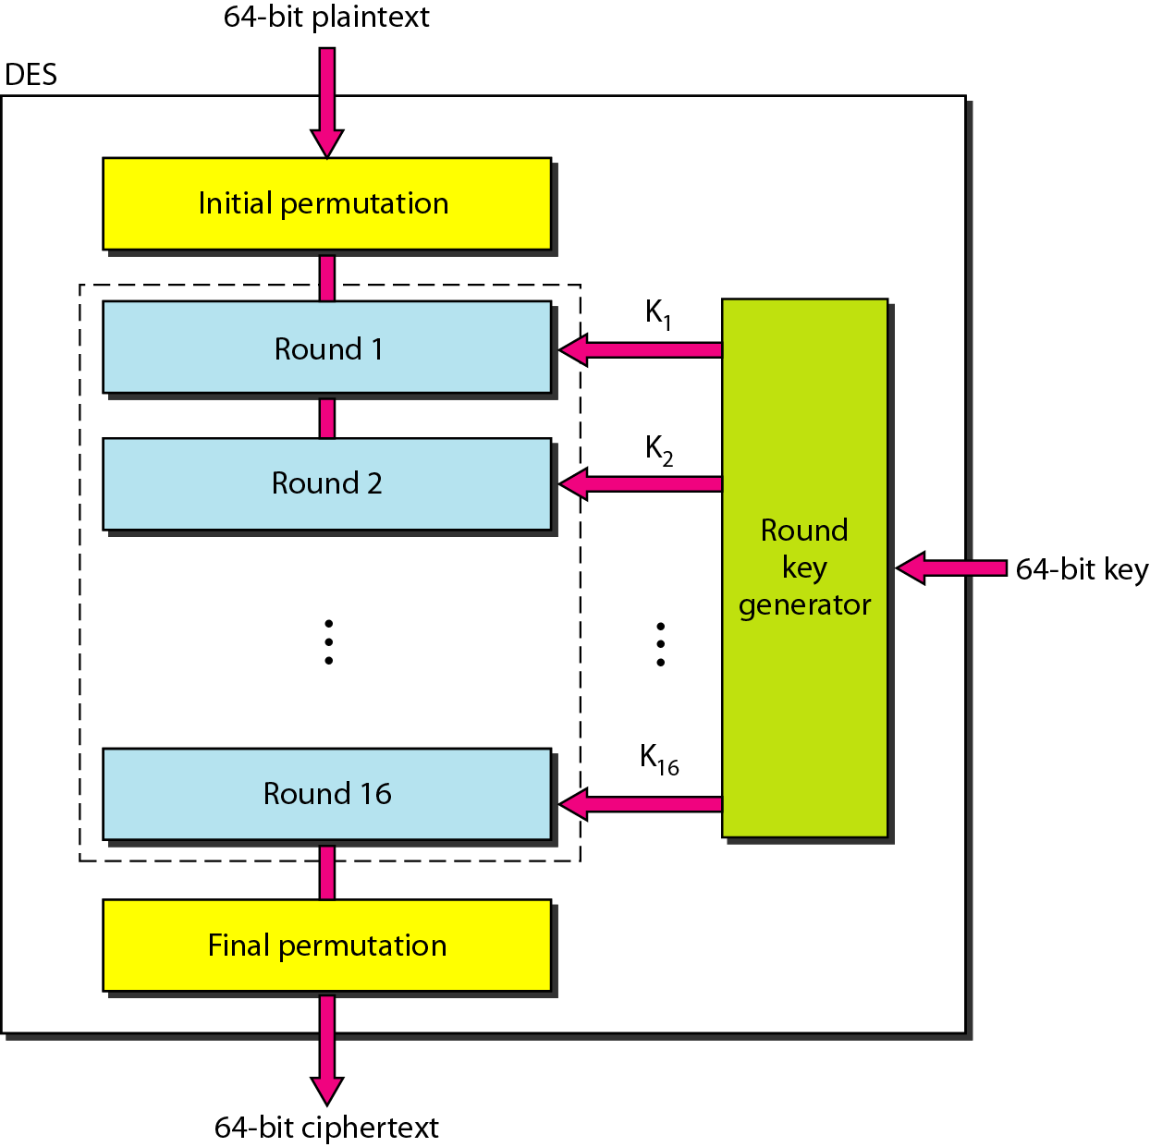
Figure 30.13 DES (Data Encryption Standard)

Slide 52
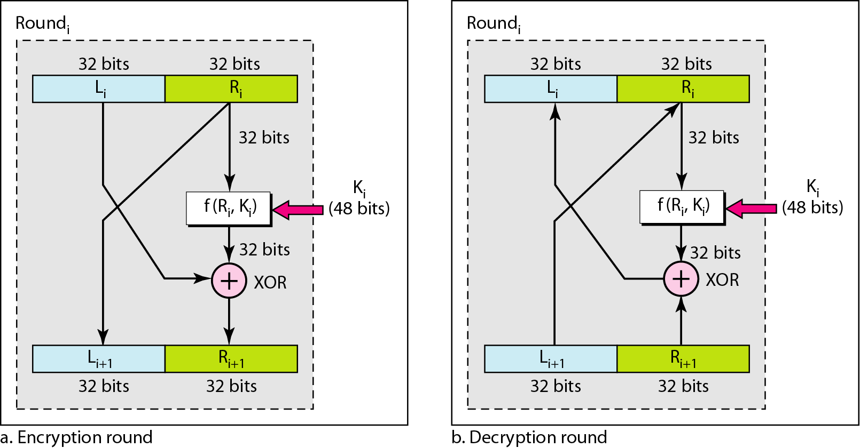
Figure 30.14 One round in DES ciphers

Slide 53
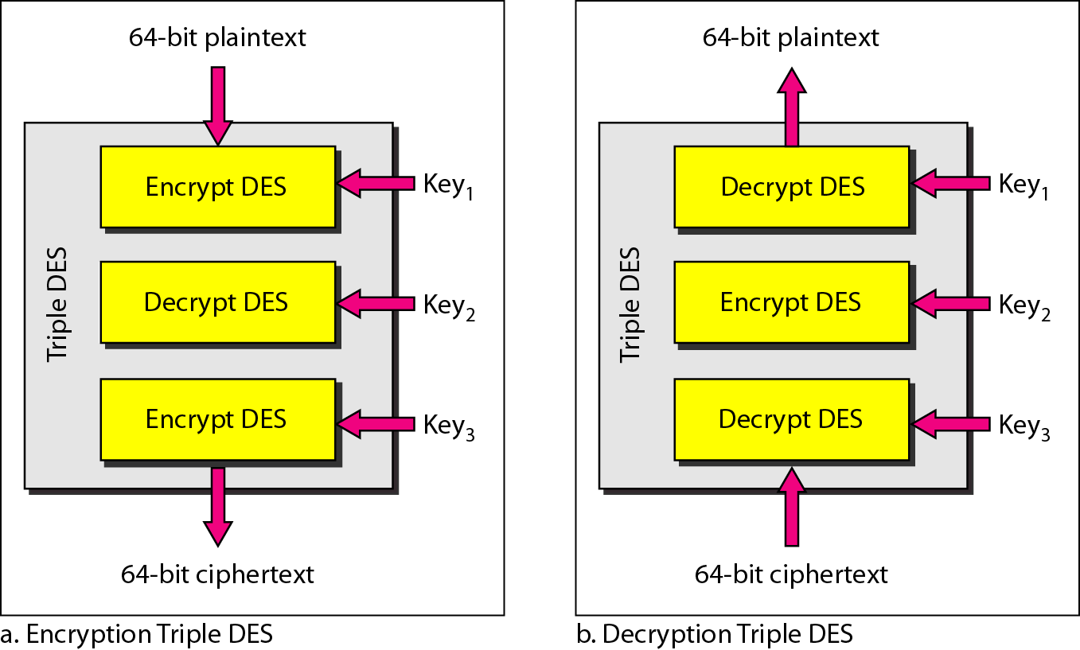
Figure 30.16 Triple DES (to resolve the short key issue for DES)

Slide 54
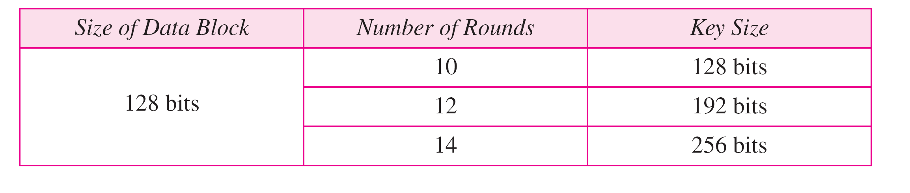
Table 30.1 AES (advanced encryption standard) configuration
AES is the replacement of DES
Note
AES has three different configurations with respect to the number of rounds and key size.

Slide 55
30-3 ASYMMETRIC-KEY CRYPTOGRAPHY
An asymmetric-key (or public-key) cipher uses two keys: one private and one public. We discuss two algorithms: RSA and Diffie-Hellman.
Topics discussed in this section:
RSA Diffie-Hellman

Slide 56
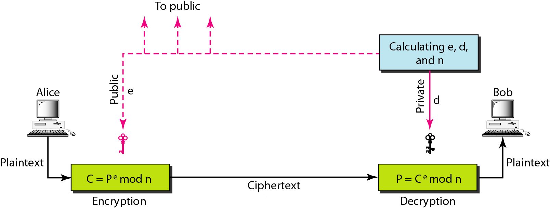
Figure 30.24 RSA

Slide 57
RSA: Choosing keys
1. Choose two large prime numbers p, q.
(e.g., 1024 bits each)
2. Compute n = pq, Φ = (p-1)(q-1)
3. Choose e (with e<n) that has no common factors
with Φ. (e, Φ are “relatively prime”).
4. Choose d such that ed-1 is exactly divisible by Φ.
(in other words: ed mod Φ = 1 ).
5. Public key is (n,e). Private key is (n,d).
+
-
K
K
B
B

Slide 58
RSA: Encryption, decryption
0. Given (n,e) and (n,d) as computed above
1. To encrypt bit pattern, m, compute
e
c = m mod n
e
(i.e., remainder when m is divided by n)
2. To decrypt received bit pattern, c, compute
d
m = c mod n
d
(i.e., remainder when c is divided by n)
Magic
happens!
e
d
m = (m mod n)
mod n
c

Slide 59
RSA example:
Bob chooses p=5, q=7. Then n=35, Φ =24.
e=5 (so e, Φ relatively prime).
d=29 (so ed-1 exactly divisible by Φ).
m
e
e
letter
m
c = m mod n
encrypt:
l
12
1524832
17
d
d
c
c
m = c mod n
letter
decrypt:
17
481968572106750915091411825223071697
12
l
Computational very extensive

Slide 60
Note
In RSA, e and n are announced to the public; d and Φ are kept secret.
Public cryptography is very computational expensive.

Slide 61
Access Control

Slide 62
Access Control
Two methods of information control:
control access
control use or comprehension
Access Control Methods
Network topology and services (later)
Passwords/Authentication methods
File Protection

Slide 63

Authentication
Four classic ways to authenticate:
something you know (passwords)
something you have (smartcard)
something you are (fingerprint)
something you do (usage signature)
None of these is perfect

Slide 64
Passwords
Account - person using the system
Username - Identity of account (public)
limited characters, alphanumeric & special characters
typically related to real name of user (not always), certain names reserved
unique on system
fixed at account creation
Passwords – Verification of identity (private)
Less limited length and characters
Fixed until changed
Non-unique passwords – both users have bad password
Many Multi-user Operating Systems have same scheme

Slide 65
Password Security
Password security depends on ONLY you knowing the password
Secure selection
Secure handling
Secure storage

Slide 66
Password Storage
“trapdoor encrypted”
scrambled in a way that cannot be unscrambled
scrambling folds password over itself - lost bits
different users with same password won’t have same scrambled password
login scrambles entered password and compares against stored scrambled password
original concept: since only scrambled passwords are available, storage is secure (FALSE!)
shimeall:kr1eWN8N2pyAA

Slide 67
Password Attacks
Easy to Hard
Given password
Grab password
Generate password
Guess password

Slide 68
Given Password
Look It Up
Default passwords
Posted passwords
Ask for It (Social Engineering)
As colleague
As friend
As administrator / authority
As clueless & needy
Countermeasures
Education
Reverse Social Engineering
Locked accounts
Other authentication

Slide 69
Grab Password (locally)
Physical proximity
Shoulder surfing
Countermeasures
Education
Exercises
One-time passwords
Program access
Trojan Horse
Perverted program
Countermeasures
Integrity checks
Other authentication

Slide 70
Local Network Operation
Under normal conditions, the data in a packet transmitted over the network is read
only by the destination system to which it is addressed.
Router
Notes:
Quickly define packet in course of discussion. DON’T PATRONIZE!
Also briefly walk through base diagram, as it is used over the next few slides.
Just walk through explanations of what is happening on the following slides.

Slide 71
Packet Sniffing
When a packet sniffer is present, a copy of all packets that pass by it on the network are covertly captured.
Router
Packet Sniffer
Executing
Notes:
There are technical fixes to this -- including good choice of network cards so that most hosts on your net cannot support sniffers (but this needs to be specified in policy). Can also monitor your network to spot sniffers executing, but this needs staffing and authorization.

Slide 72
Wide Area Network Operation
Always Switched
Circuit-Switched
Packet-Switched
Switch Settings determine route
Choice Points: Routers
Connect two or more networks
Maintain information on best routes
Exchange information with other routers

Slide 73
Network Redirection
Intruders can fool routers into sending traffic to unauthorized locations
Notes:
Fix is to have routers listen only to approved information sources, but this may involve pressure on vendors to fix current problems, as well as defining what an “approved information source” is. Many sites cannot afford to sacrifice flexibility in connectivity, so may have some tradeoffs here.

Slide 74
Other Network Attacks
Tapping
Method depends on network medium
Countermeasures:
Encryption
Physical protection & inspection
Van Eck Radiation
Current through wire: Radio waves
Receiver tunes in on hosts/network
Countermeasures:
Encryption
Distance
Emission Control

Slide 75
Generate Password
Use a dictionary
Requires: Scrambled password, Encryption method & Large dictionary
Password Cracking
Natural language words and slang
Backwards / Forwards / Punctuation and Numbers inserted
Program: 27,000 passwords in approx 3 seconds (Pentium II/133)
Countermeasures
Preventive strike (BEWARE)
Password rules
Other authentication

Slide 76
Guess Password
Use knowledge of user
System information
Personal information
Occupation information
Often combined with dictionary attack
Countermeasures
Password rules
Other authentication

Slide 77
Passwords on Many Machines
One or Many?
Ease of memorization vs. likelihood of writing
Options:
Secure stored passwords
Network authentication method
Algorithm for varying passwords

Slide 78
Something You Have
Convert logical security to physical security
One-time pad
Strip card / smart card
Dongle
Challenge-Response calculator
Problems: Cost & token issuing/handling
Advantages: Physical presence; hard to hack

Slide 79
Something You Are
Biometrics: Measure physical characteristic
Face geometry
Hand geometry
Fingerprint
Voiceprint
Retinal Scan
Signature
Advantages: Physical presence, not easily lost
Disadvantages: Cost, Security, Variation, Handicaps

Slide 80
Authentication Summary
Many different options available
None perfect
Combined solutions are possible
Risk: assumption that other method will protect weaknesses
Overlapping design needed

Slide 81
Computer Files
File: almost every visible aspect of system
Human names vs. Computer reference
Information on files:
Location
Size
Type
Creation and access times
Owner
Protections

Slide 82
File Protections
File Permissions: grouped usage
Owner, Collaborators and others
Read, Write, Execute, etc. allowed
Access Control Lists: who can do what
Account name and permissions
Syntax and Semantics depend on Operating System

Slide 83
Using File Permissions
Be as restrictive as reasonable
Use minimal permissions as defaults
Enforce individual account usage
Use directory permissions
“Something everyone owns, no one owns”

Slide 84
Defeating File Permissions
Physical access:
Reboot under different Operating System
Raw access
Subvert applications
Trojan Horses
Direct corruption
Virus
Countermeasures:
Physical protection
Disk encryption
Configuration Control
Integrity checking

Slide 85
Database Security

Slide 86
30.1 Introduction to Database Security Issues
Database security a broad area
Legal, ethical, policy, and system-related issues
Threats to databases
Loss of integrity
Improper modification of information
Loss of availability
Legitimate user cannot access data objects
Loss of confidentiality
Unauthorized disclosure of confidential information

Slide 87
Introduction to Database Security Issues (cont’d.)
Database works as part of a network of services
Applications, Web servers, firewalls, SSL terminators, and security monitoring systems
Types of database control measures
Access control
Inference control
Flow control
Encryption

Slide 88
Introduction to Database Security Issues (cont’d.)
Discretionary security mechanisms
Used to grant privileges to users
Mandatory security mechanisms
Classify data and users into various security classes
Implement security policy
Role-based security

Slide 89
Introduction to Database Security Issues (cont’d.)
Control measures
Access control
Handled by creating user accounts and passwords
Inference control
Must ensure information about individuals cannot be accessed
Flow control
Prevents information from flowing to unauthorized users
Data encryption
Used to protect sensitive transmitted data

Slide 90
Database Security and the DBA
Database administrator (DBA)
Central authority for administering database system
Superuser or system account
DBA-privileged commands
Account creation
Privilege granting
Privilege revocation
Security level assignment

Slide 91
Access Control, User Accounts, and Database Audits
User must log in using assigned username and password
Login session
Sequence of database operations by a certain user
Recorded in system log
Database audit
Reviewing log to examine all accesses and operations applied during a certain time period

Slide 92
Sensitive Data and Types of Disclosures
Sensitivity of data
Inherently sensitive
From a sensitive source
Declared sensitive
A sensitive attribute or sensitive record
Sensitivity in relation to previously disclosed data

Slide 93
Sensitive Data and Types of Disclosures (cont’d.)
Factors in deciding whether it is safe to reveal the data
Data availability
Not available when being updated
Access acceptability
Authorized users
Authenticity assurance
External characteristics of the user
Example: access only allowed during working hours

Slide 94
Sensitive Data and Types of Disclosures (cont’d.)
Typically a tradeoff between precision and security
Precision
Protect all sensitive data while making available as much nonsensitive data as possible
Security
Ensuring data kept safe from corruption and access suitably controlled

Slide 95
Relationship Between Information Security and Information Privacy
Concept of privacy goes beyond security
Ability of individuals to control the terms under which their personal information is acquired and used
Security a required building block for privacy
Preventing storage of personal information
Ensuring appropriate use of personal information
Trust relates to both security and privacy

Slide 96
30.2 Discretionary Access Control Based on Granting and Revoking Privileges
Two levels for assigning privileges to use a database system
Account level
Example: CREATE SCHEMA or CREATE TABLE privilege
Not defined for SQL2
Relation (or table) level
Defined for SQL2
Access matrix model

Slide 97
Discretionary Access Control (cont’d.)
Relation or table level (cont’d.)
Each relation R assigned an owner account
Owner of a relation given all privileges on that relation
Owner can grant privileges to other users on any owned relation
SELECT (retrieval or read) privilege on R
Modification privilege on R
References privilege on R

Slide 98
Specifying Privileges Through the Use of Views
Consider owner A of relation R and other party B
A can create view V of R that includes only attributes A wants B to access
Grant SELECT on V to B
Can define the view with a query that selects only those tuples from R that A wants B to access

Slide 99
Revocation and Propagation of Privileges
Revoking of Privileges
Useful for granting a privilege temporarily
REVOKE command used to cancel a privilege
Propagation of privileges using the GRANT OPTION
If GRANT OPTION is given, B can grant privilege to other accounts
DBMS must keep track of how privileges were granted if DBMS allows propagation

Slide 100
Revocation and Propagation of Privileges (cont’d.)
Horizontal and vertical propagation limits
Limiting horizontal propagation to an integer number i
Account B given the GRANT OPTION can grant the privilege to at most i other accounts
Vertical propagation limits the depth of the granting of privileges
Not available currently in SQL or other relational systems

Slide 101
30.3 Mandatory Access Control and Role-Based Access Control for Multilevel Security
Mandatory access control
Additional security policy that classifies data and users based on security classes
Typical security classes
Top secret
Secret
Confidential
Unclassified
Bell-LaPadula model
Subject and object classifications

Slide 102
Mandatory Access Control and Role-Based Access Control for Multilevel Security (cont’d.)
Simple security property
Subject S not allowed read access to object O unless class(S)≥class(O)
Star property
Subject not allowed to write an object unless class(S)≤class(O)
Prevent information from flowing from higher to lower classifications
Attribute values and tuples considered as data objects

Slide 103
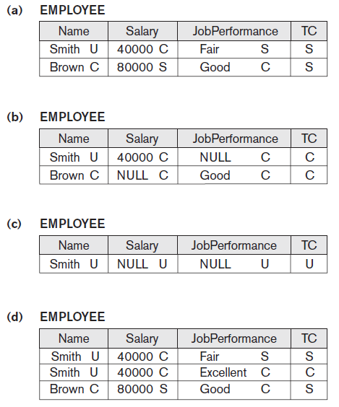
Figure 30.2 A multilevel relation to illustrate multilevel security (a) The original EMPLOYEE tuples (b) Appearance of EMPLOYEE after filtering for classification C users (c) Appearance of
EMPLOYEE after filtering
for classification U users
(d) Polyinstantiation of the
Smith tuple

Slide 104
Comparing Discretionary Access Control and Mandatory Access Control
DAC policies have a high degree of flexibility
Do not impose control on how information is propagated
Mandatory policies ensure high degree of protection
Rigid
Prevent illegal information flow

Slide 105
Role-Based Access Control
Permissions associated with organizational roles
Users are assigned to appropriate roles
Can be used with traditional discretionary and mandatory access control
Mutual exclusion of roles
Authorization time exclusion
Runtime exclusion
Identity management

Slide 106
Label-Based Security and Row-Level Access Control
Sophisticated access control rules implemented by considering the data row by row
Each row given a label
Used to prevent unauthorized users from viewing or altering certain data
Provides finer granularity of data security
Label security policy
Defined by an administrator

Slide 107
XML Access Control
Digital signatures for XML
XML Signature Syntax and Processing specification
Defines mechanisms for countersigning and transformations
XML encryption
XML Encryption Syntax and Processing specification
Defines XML vocabulary and processing rules

Slide 108
Access Control Policies for the Web and Mobile Applications
E-commerce environments require elaborate access control policies
Go beyond traditional DBMSs
Legal and financial consequences for unauthorized data breach
Content-based access control
Takes protection object content into account
Credentials

Slide 109
30.4 SQL Injection
SQL injection
Most common threat to database system
Other common threats
Unauthorized privilege escalation
Privilege abuse
Denial of service
Weak authentication

Slide 110
SQL Injection Methods
Attacker injects a string input through the application
Changes or manipulates SQL statement to attacker’s advantage
Unauthorized data manipulation or execution of system-level commands
SQL manipulation
Changes an SQL command in the application
Example: adding conditions to the WHERE clause

Slide 111
SQL Injection Methods (cont’d.)
SQL manipulation (cont’d.)
Typical manipulation attack occurs during database login
Code injection
Add additional SQL statements or commands that are then processed
Function call injection
Database or operating system function call inserted into vulnerable SQL statement to manipulate data or make a privileged system call

Slide 112
Risks Associated with SQL Injection
Database fingerprinting
Denial of service
Bypassing authentication
Identifying injectable parameters
Executing remote commands
Performing privilege escalation

Slide 113
Protection Techniques
Blind variables (using parameterized statements)
Protects against injection attacks
Improves performance
Filtering input (input validation)
Remove escape characters from input strings
Escape characters can be used to inject manipulation attacks
Function security
Standard and custom functions should be restricted

Slide 114

30.5 Introduction to Statistical Database Security
Statistical databases used to provide statistics about various populations
Users permitted to retrieve statistical information
Must prohibit retrieval of individual data
Population: set of tuples of a relation (table) that satisfy some selection condition
Figure 30.3 The PERSON relation schema for illustrating statistical database security

Slide 115
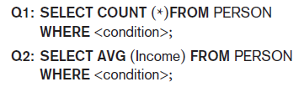
Introduction to Statistical Database Security (cont’d.)
Only statistical queries are allowed
Preventing the inference of individual information
Provide minimum threshold on number of tuples
Prohibit sequences of queries that refer to the same population of tuples
Introduce slight noise or inaccuracy
Partition the database
Store records in groups of minimum size

Slide 116
30.6 Introduction to Flow Control
Flow control
Regulates the distribution or flow of information among accessible objects
Verifies information contained in some objects does not flow explicitly or implicitly into less protected objects
Flow policy
Specifies channels along which information is allowed to move
Simple form: confidential and nonconfidential

Slide 117
Introduction to Flow Control (cont’d.)
Covert channels
Allows information to pass from a higher classification level to a lower classification level through improper means
Timing channel requires temporal synchronization
Storage channel does not require temporal synchronization

Slide 118
30.7 Encryption and Public Key Infrastructures
Encryption converts data into cyphertext
Performed by applying an encryption algorithm to data using a prespecified encryption key
Resulting data must be decrypted using a decryption key to recover original data
Data Encryption Standard (DES)
Developed by the U.S. Government for use by the general public
Advanced Encryption Standard (AES)
More difficult to crack

Slide 119
Encryption and Public Key Infrastructures (cont’d.)
Symmetric key algorithms
Also called secret key algorithms
Need for sharing the secret key
Can apply some function to a user-supplied password string at both sender and receiver
Public (asymmetric) key encryption
Involves public key and private key
Private key is not transmitted
Two keys related mathematically
Very difficult to derive private key from public key

Slide 120
Encryption and Public Key Infrastructures (cont’d.)
Public (asymmetric) key encryption steps
Each user generates a pair of keys to be used for encryption and decryption of messages
Each user places public key in a public register or other accessible file
Keeps companion key private
Sender encrypts message using receiver’s public key
Receiver decrypts message using receiver’s private key
RSA public key encryption algorithm

Slide 121
Digital Signatures
Consist of string of symbols
Each is unique
Function of the message it is signing, along with a timestamp
Depends on secret number unique to the signer
Public key techniques used to create digital signatures

Slide 122
Digital Certificates
Combines value of a public key with the identity of the person or service that holds the corresponding private key into a digitally signed statement
Information included in the certificate
Owner information
Public key of the owner
Date of certificate issue and validity period
Issuer identification
Digital signature

Slide 123
30.8 Privacy Issues and Preservation
Growing challenge for database security
Limit performing large-scale mining and analysis
Central warehouses for vital information
Violating security could expose all data
Distributed data mining algorithms
Remove identity information in released data
Inject noise into the data
Must be able to estimate errors introduced
Mobile device privacy

Slide 124
30.9 Challenges to Maintaining Database Security
Data quality
Quality stamps
Application-level recovery techniques to automatically repair incorrect data
Intellectual property rights
Digital watermarking techniques

Slide 125
Challenges to Maintaining Database Security (cont’d.)
Database survivability
Confinement
Damage assessment
Reconfiguration
Repair
Fault treatment

Slide 126
30.10 Oracle Label-Based Security
Oracle label security
Enables row-level access control
Every table or view has an associated security policy
Virtual private database (VPD) technology
Feature that adds predicates to user statements to limit their access in a transparent manner to the user and the application
Based on policies

Slide 127
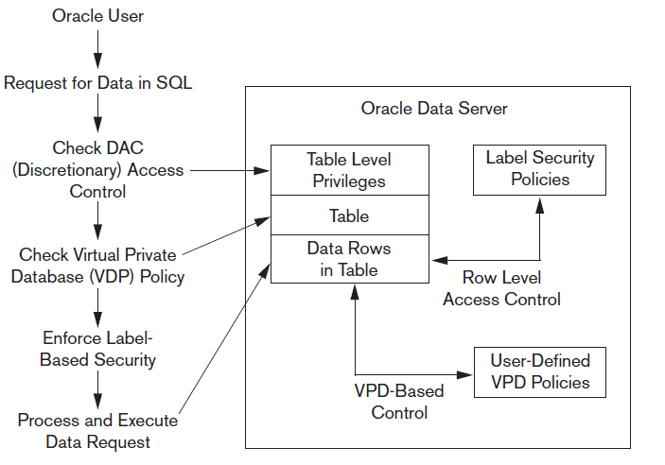
Label Security Architecture
Figure 30.4 Oracle label security architecture. Data from: Oracle (2007)

Slide 128
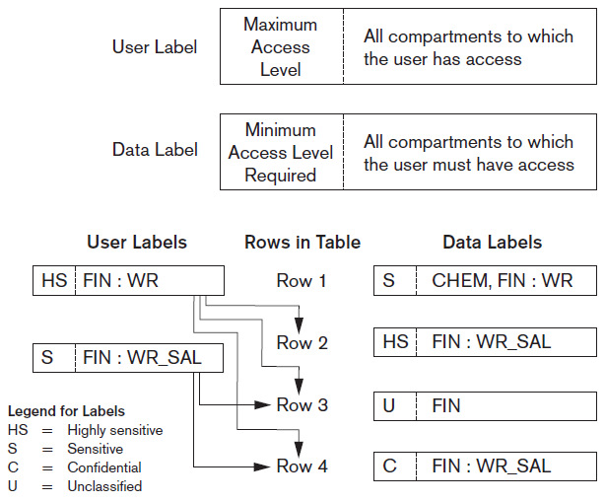
How Data Labels and User Labels Work Together
Figure 30.5 Data labels and user labels in Oracle. Data from: Oracle (2007)

Slide 129
30.11 Summary
Threats to databases
Types of control measures
Access control
Inference control
Flow control
Encryption
Mandatory access control
SQL injection
Key-based infrastructures

Slide 130
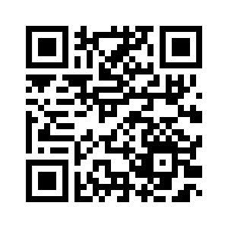
Thank you

